Slide 1
Chapter 21

Slide 2
Objectives

Slide 3
Objectives (cont.)

Slide 4
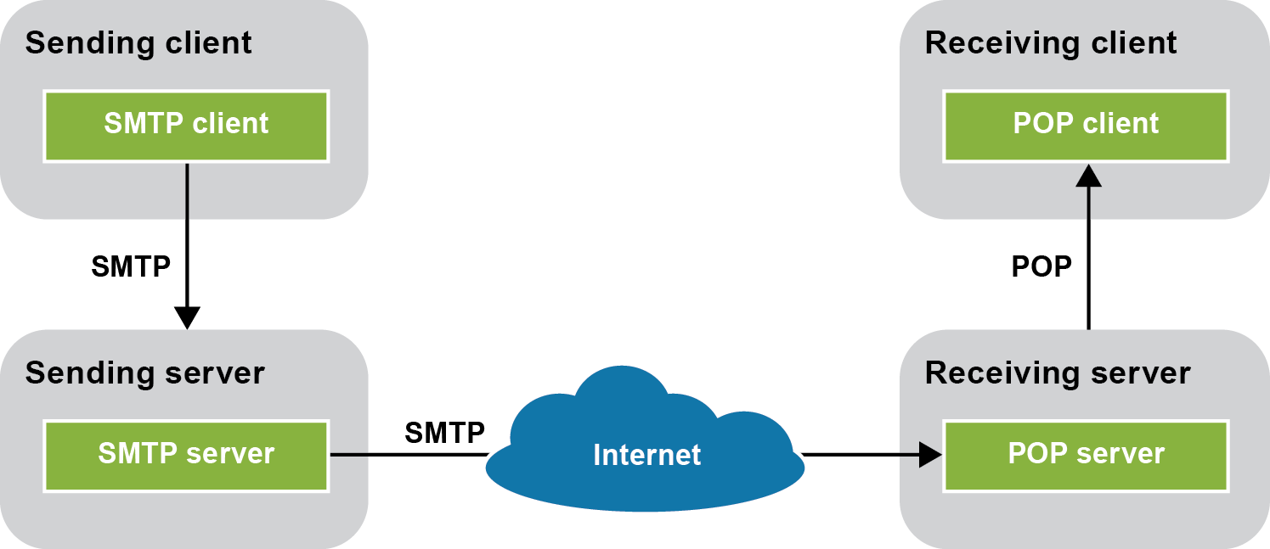
How email works

Slide 5
Three email protocols

Slide 6
Three common reasons for sending email

Slide 7
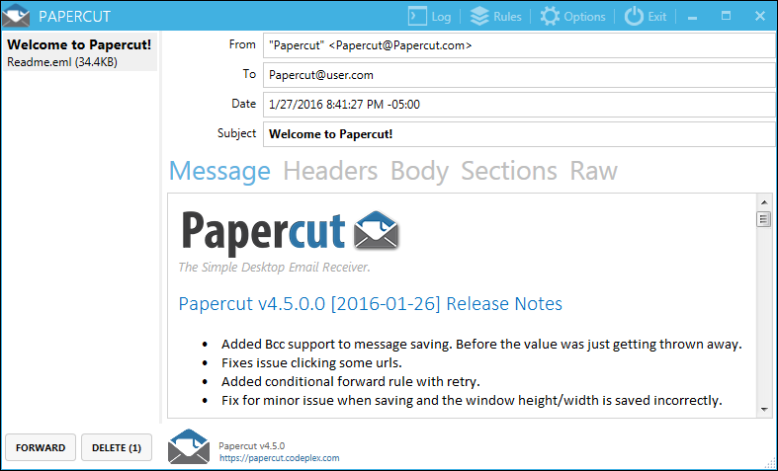
The third-party Papercut SMTP server application interface

Slide 8
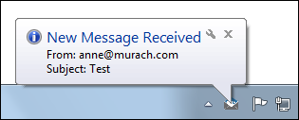
An email notification when Papercut is minimized in the system tray

Slide 9
How to install and work with Papercut

Slide 10
Constructors of the MailMessage class

Slide 11
Properties of the MailMessage class

Slide 12
Constructors of the MailAddress class

Slide 13
Code that creates an email message with a carbon copy

Slide 14
Another way to create a message

Slide 15
Constructors of the SmtpClient class
Methods of the SmtpClient class

Slide 16
SMTP configuration settings in a Web.config file

Slide 17
Code that sends a message using settings in the Web.config file
Code that creates and sends a message to a named server

Slide 18
The syntax for creating an attachment

Slide 19
One way to create a new attachment and add it to a message
Another way to create a new attachment and add it to a message

Slide 20
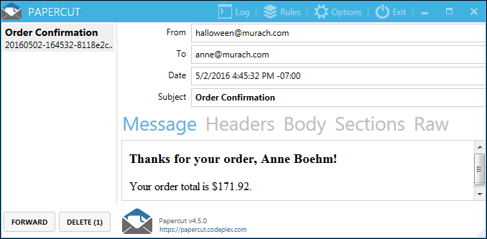
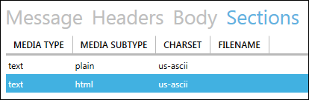
A multipart email message with both text and HTML

Slide 21
A method that sends a multipart email message

Slide 22
A method that sends a multipart email message (cont.)

Slide 23
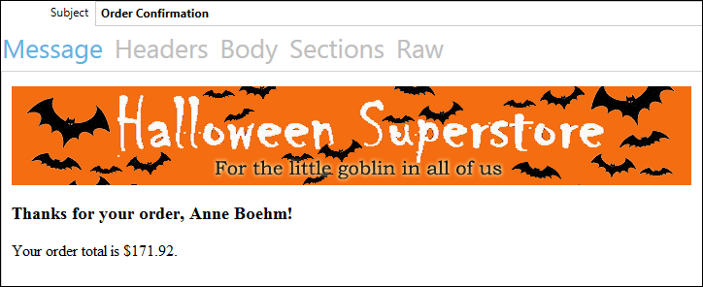
An HTML email message with an embedded image

Slide 24
A method that sends an embedded image

Slide 25
A method that sends an embedded image (cont.)

Slide 26
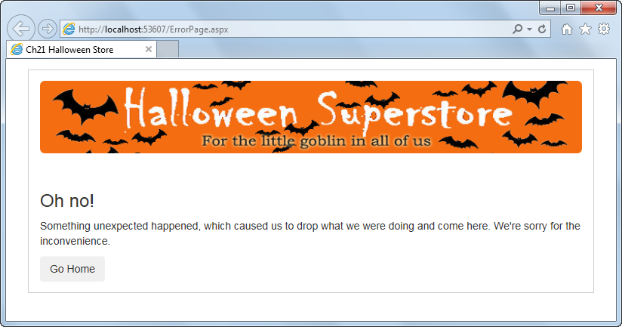
A custom error page in a browser

Slide 27
Four ways to display a custom error page when an exception occurs

Slide 28
Common properties of the Exception class

Slide 29
Methods of the HttpServerUtility class for working with exceptions

Slide 30
Code that gets the last Exception object at the method level

Slide 31
Code that gets the last Exception object at the page or application level
Code that gets the last Exception object in a non-page code file
Code that gets the inner Exception object

Slide 32
A custom error handling class

Slide 33
A custom error handling class (cont.)

Slide 34
An Application_Error method in the Global.asax file that uses the error handling class

Slide 35
A customErrors element in the Web.config file for custom error pages

Slide 36
Common HTTP error codes

Slide 37
A back-button problem in the Cart page of the Shopping Cart application

Slide 38
A back-button problem in the Cart page of the Shopping Cart application (cont.)

Slide 39
Three ways to handle the back-button problem

Slide 40
The normal postback pattern for a page

Slide 41
The C# code for a method that uses the normal postback pattern

Slide 42
The Post-Redirect-Get (PRG) pattern for a page

Slide 43
The C# code for a method that uses the PRG pattern

Slide 44
A page that checks timestamps

Slide 45
A page that checks timestamps (cont.)

Slide 46
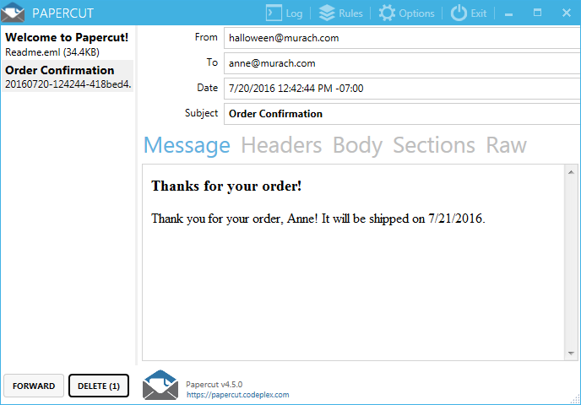
Extra 21-1 Send an email from the Halloween Store application

Slide 47
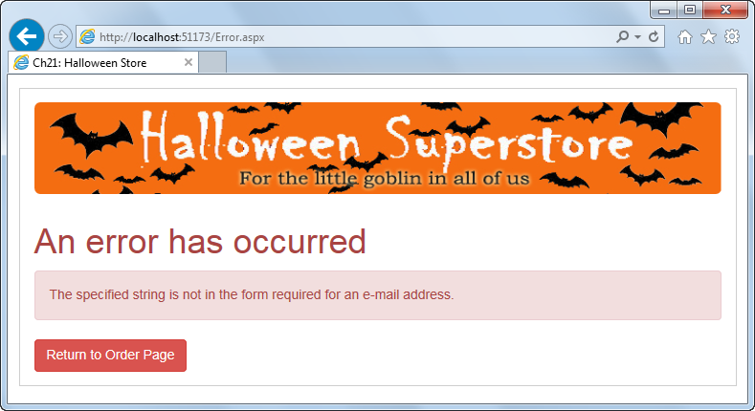
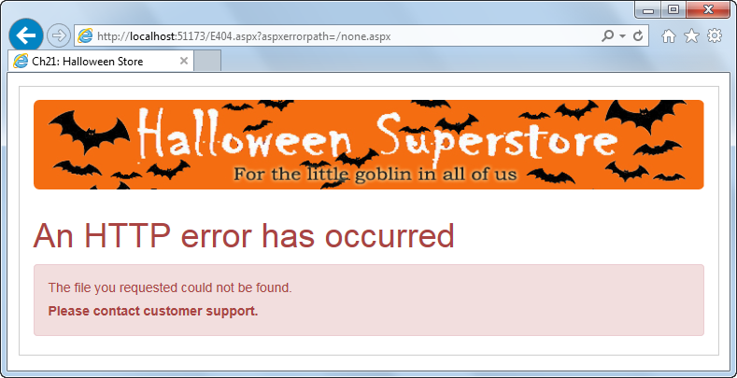
Extra 21-2 Add custom error handling to the Halloween Store application

Slide 48
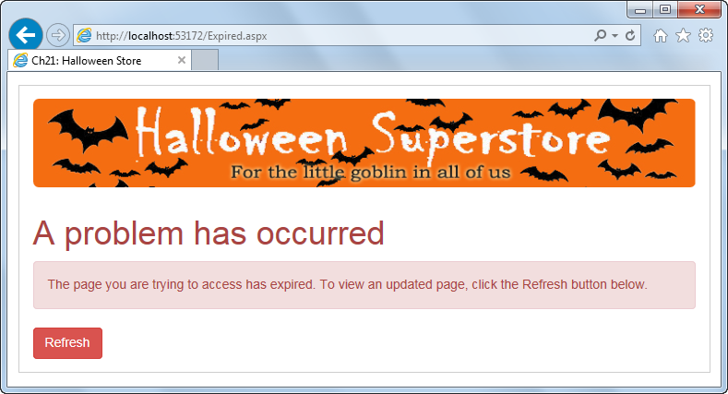
Extra 21-3 Handle the back-button problem in the Halloween Store application

